Slide 1
Exercise 2021/1
Mission 4: Astiles

Slide 2
ROLL CALL
Flight | Pilot
Hornet1-1 | Astiles
Hornet1-2 | Raus
Hornet1-3 | Chicho
Hornet1-4 | Magoo
Hornet2-1 | Jaja
Hornet2-2 | Selot
Viper1-1 | Abigor
Viper1-2 | Xifu
Cobra1-1 | Jason
Cobra1-2 | Pacotre

Slide 3
FORCE COMPOSITION
HORNET1 – 4xF/A-18C SWEEP (9/7,0,2,+) 0/1 AGM-88C // 1 FT 330
HORNET2 – 2xF/A-18C SEAD (4,0,2,+) 3 AGM-88C // 1 FT 330
VIPER1 – 2xF-16C STRIKE (2,0,2,+) 4 LGB-12 // 2 FT 370
COBRA1 – 2xAV-8 STRIKE (0,0,2,+) 2 LGB-12 // 2 FT 300
OVERLORD – E3C C2
ARCO – KC-135MPRS AAR
TEXACO – KC135 AAR

Slide 4
TIMEHACK
GPS (EXCEPTO VIPER TIESO ROLEX)

Slide 5
GENERAL OVERVIEW COMMANDER’S INTENT
ATTRIT/DEGRADE OPFOR AIR DEFENSES :
HORNET2: SA-2 (DONKEY) & SA-11 (LOCUST)
DESTROY GROUND FACILITIES:
VIPER 1:
GECKO COMPLEX
SHEEP COMM TWR
COBRA 1:
SKUNK EWR
CDE
1 LOW. NO RESTRICTIONS IN WEAPON EMPLOYMENT

Slide 6
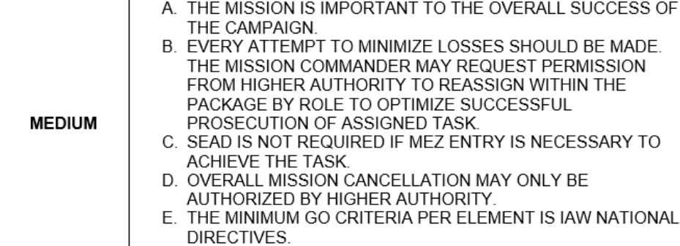
GENERAL OVERVIEW RISK LEVEL

Slide 7
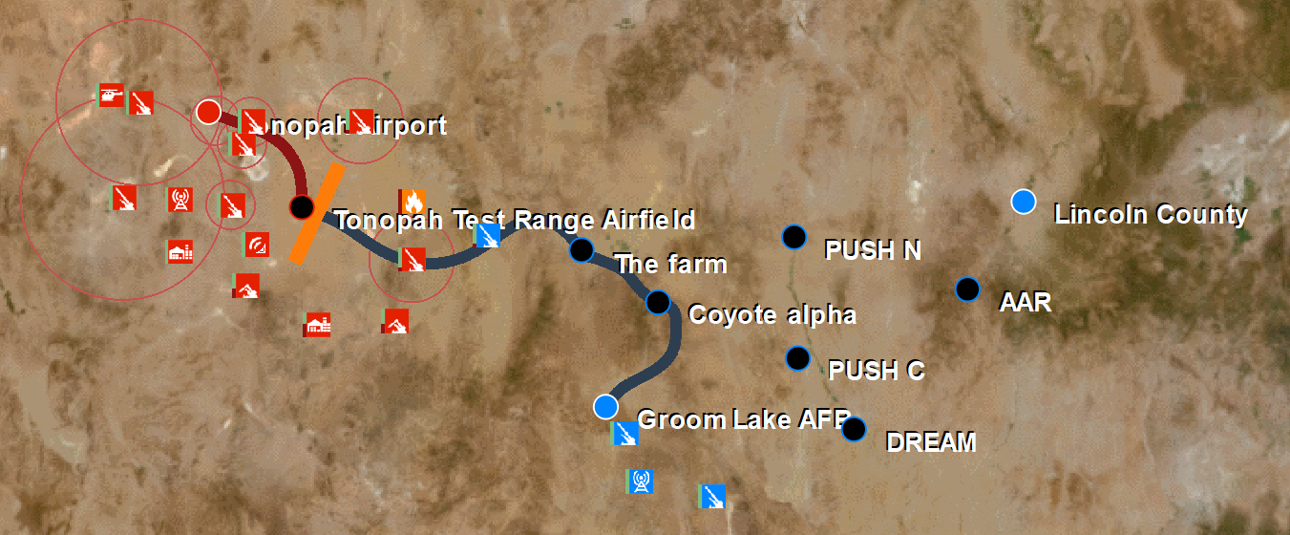
GENERAL OVERVIEW BIG PICTURE
TONOPAH AB
9 SU-30
16 MIG29S
TONOPAH TR
NO OPERATIONAL

Slide 8
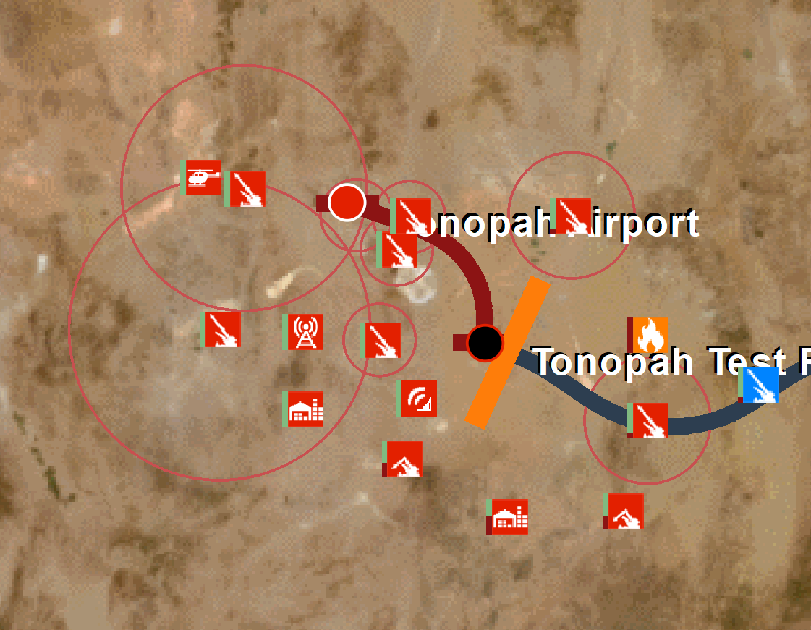
INTEL
TONOPAH AB
9 SU-30
16 MIG29S
TONOPAH TR
NO OPERATIONAL
25NM

Slide 9
INTEL
TONOPAH AB
9 SU-30
16 MIG29S
TONOPAH TR
NO OPERATIONAL
21/317

Slide 10
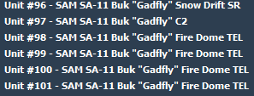
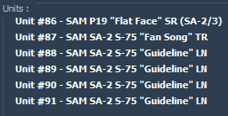
INTEL – SBAD TREAT
TONOPAH AB
9 SU-30
16 MIG29S
SA-11
LOCUST
SA-8
TONOPAH TR
NO OPERATIONAL
SA-2
DONKEY
SA-8
MARE

Slide 11
INTEL – AA THREAT MLCOA
TONOPAH AB
9 SU-30
16 MIG29S
TONOPAH TR
NO OPERATIONAL

Slide 12
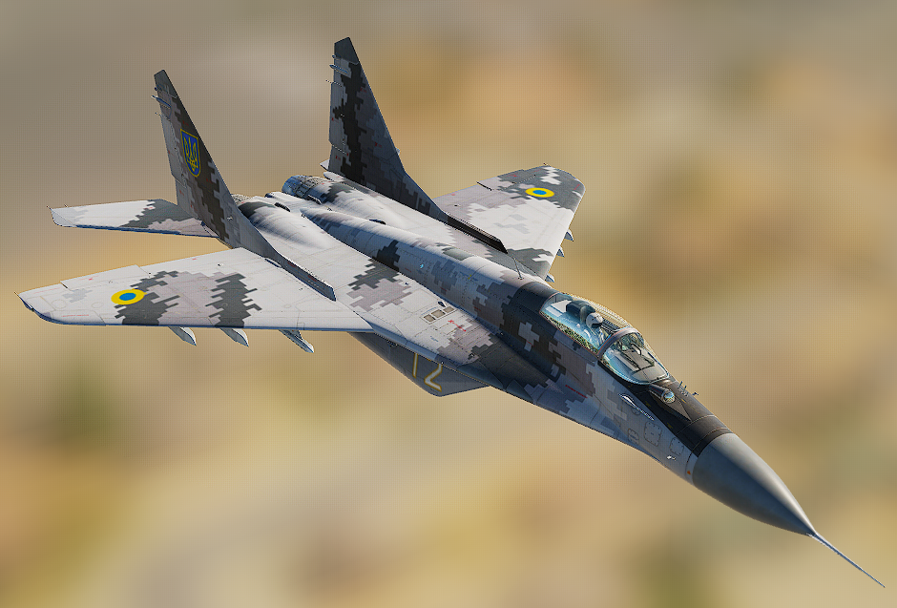
INTEL – AA THREAT MIG29S
-Look down 36nm
-RWR Detection Range 21nm
-ECM burnthrough 12-14nm
-Max Vel.: 2.0 Mach
-Turn rate 13-24º/s
-Instant rate 28º/s
-Roll: Good
-Avoid Dogfight.
-HMCS.
-Use ECM.
-Smoke exhaust.
-Break lock with beam or hard 180.
-R73 (AA-11 ARCHER) IR FOX2

Slide 13
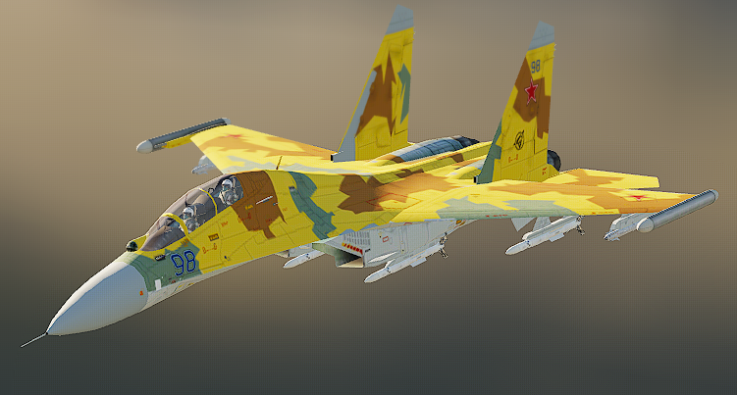
INTEL – AA THREAT SU30
-Look down 50nm
-RWR Detection Range 20nm
-ECM burnthrough 15nm
-Max Vel.: 1.8 Mach
-Turn rate 15-17º/s
-Instant rate 23º/s
-Roll: Good
-Avoid Dogfight.
-HMCS.
-Use ECM, bm, chaff, mnvr to brk lock x>10nm.
-Long rang.
-R77 (AA-12 ADDER) FOX3
-DR 20 MAR 16 DOR 25

Slide 14
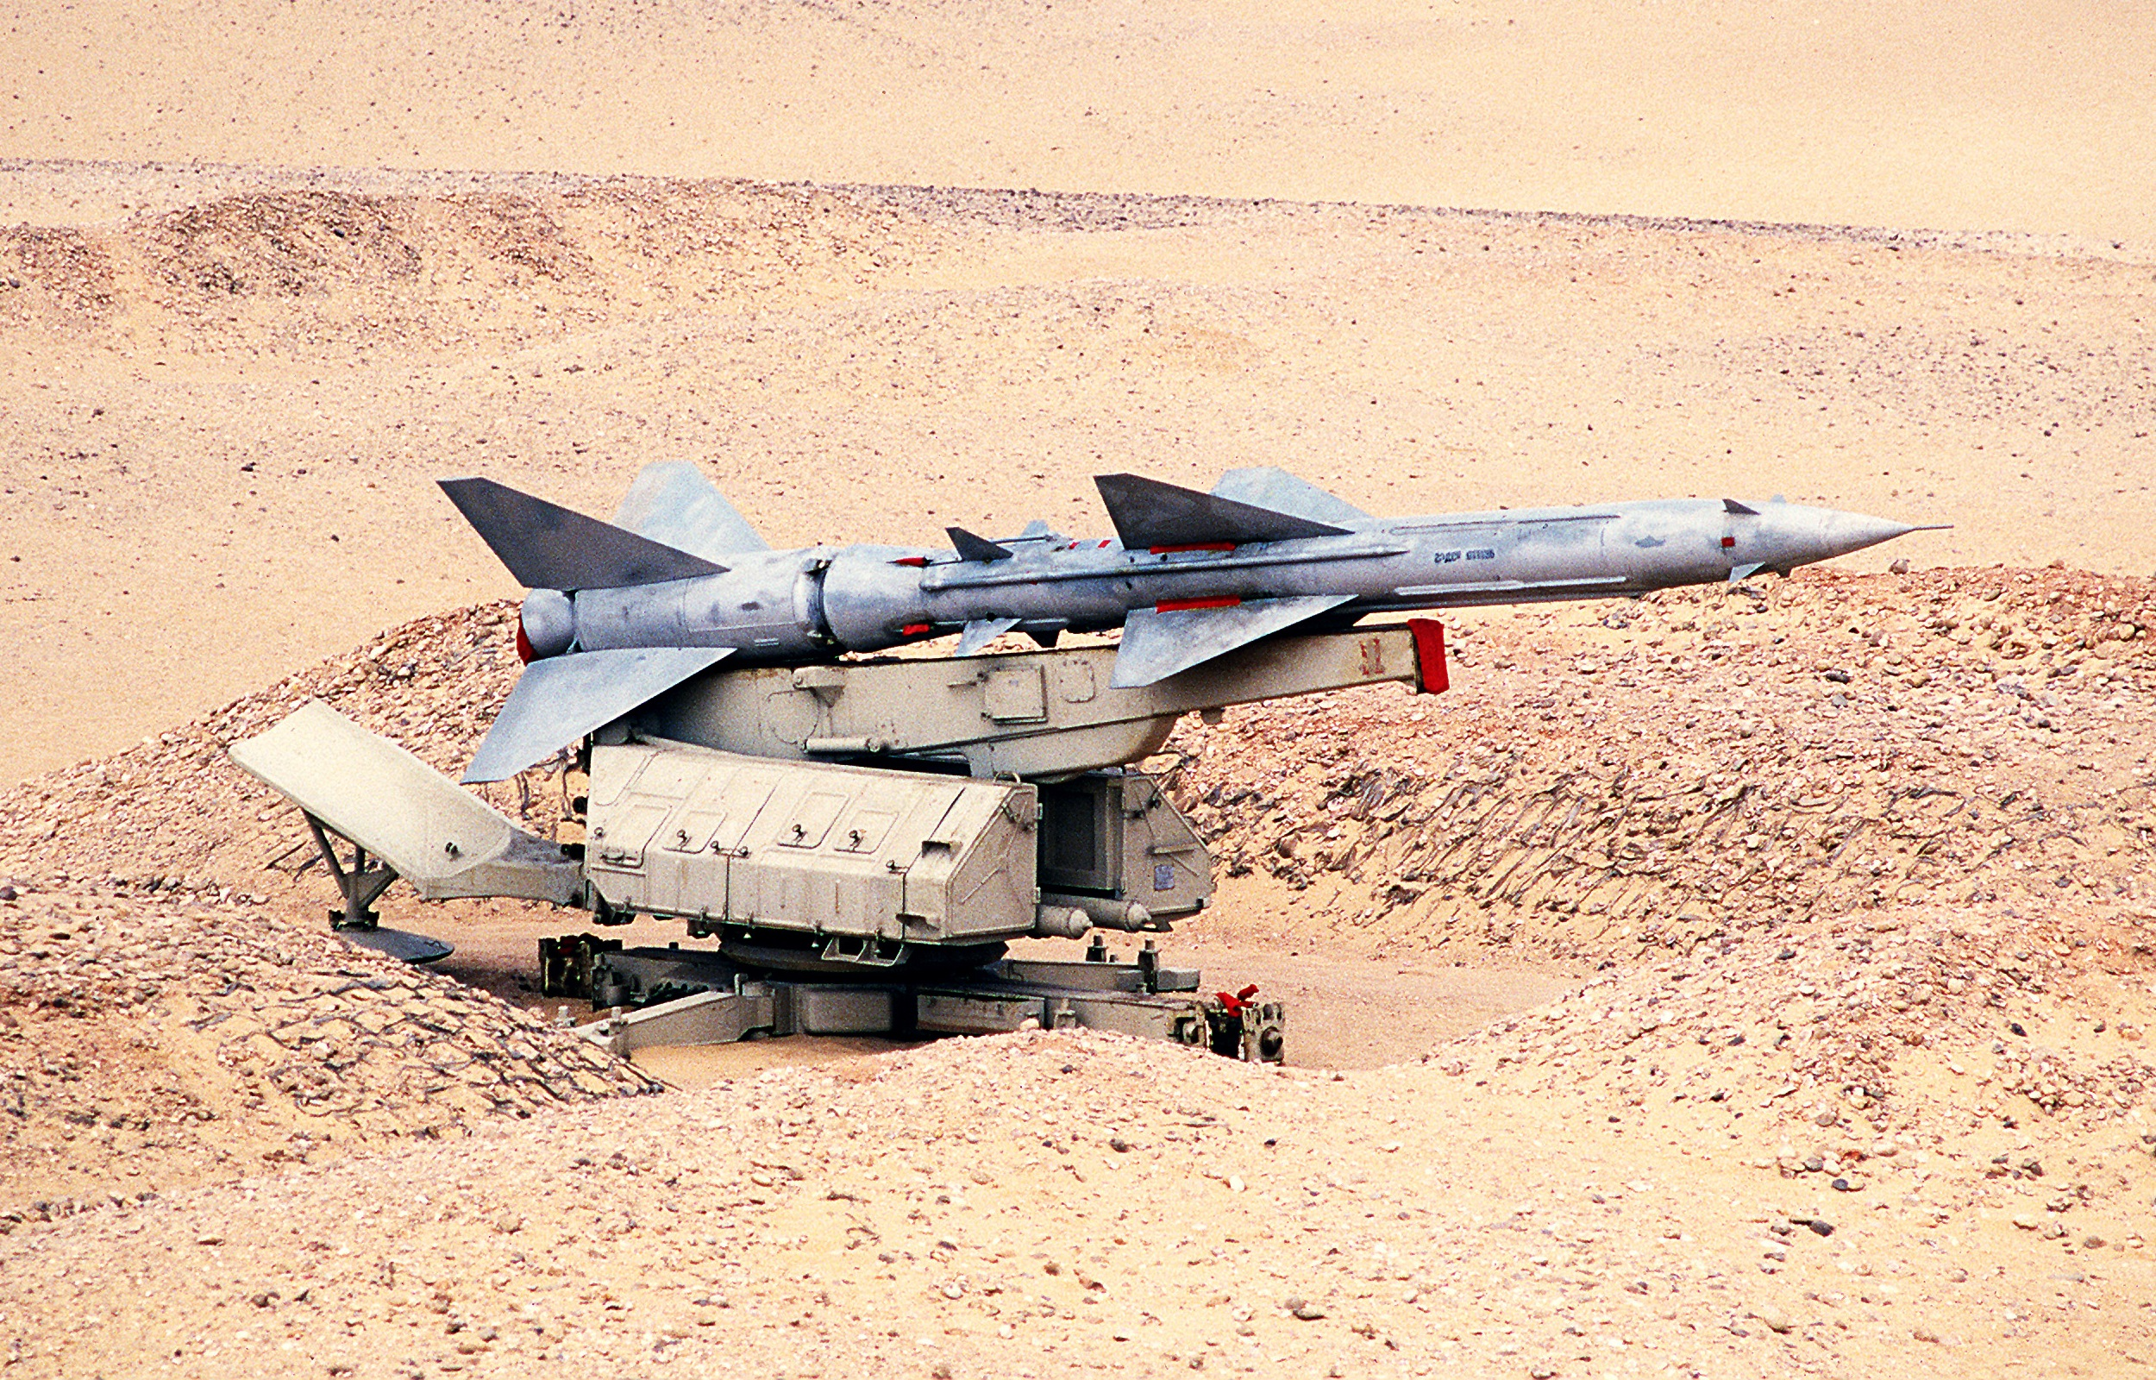
INTEL – GROUND THREAT SA-2
Min Rng/Alt = 4nm/300’
Typical Engagement: 18nm/90,000’
Max Rng/Alt = 18nm/90,000’
Chaff Vulnerability = Med
ECM Burn Through Range = 11-14nm
Missile Speed: Mach 3
How To Defeat The SA-2
Visually: First course of action should be to attempt to visually locate the missile. This is done very easily as the SA-2 leaves a huge billowing smoke plume as it accelerates towards you. Once you have located the missile place it on the beam of your aircraft and chaff.
Non-Visually: In the event that a missile is fired at you and you either cannot locate the missile visually or bad weather prevents this you have 2 options. The first option is – much like the visual method – to drag the missile and defeat it kinetically. Secondly you can perform another slice/break into the missile path (hopefully the RWR will be illuminated giving you a rough direction of the Fan Song and thusly the location of the missile).
The best way to avoid being launched on is to stay outside of the threat ring itself.
How To Destroy a SA-2: Destroy the following by any means;
1X Spoon Rest to eliminate long range searching
1X Fan Song to disable missile guidance capacity of the site.
6-10X V-750 launchers in order to eliminate the missiles themselves.

Slide 15
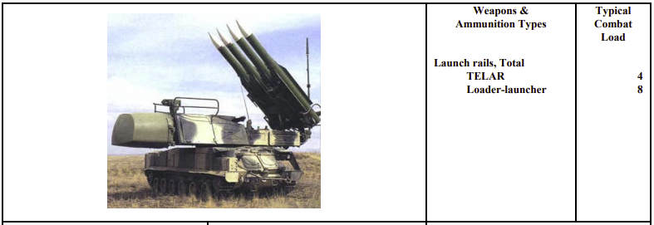
INTEL – GROUND THREAT SA-11

Slide 16
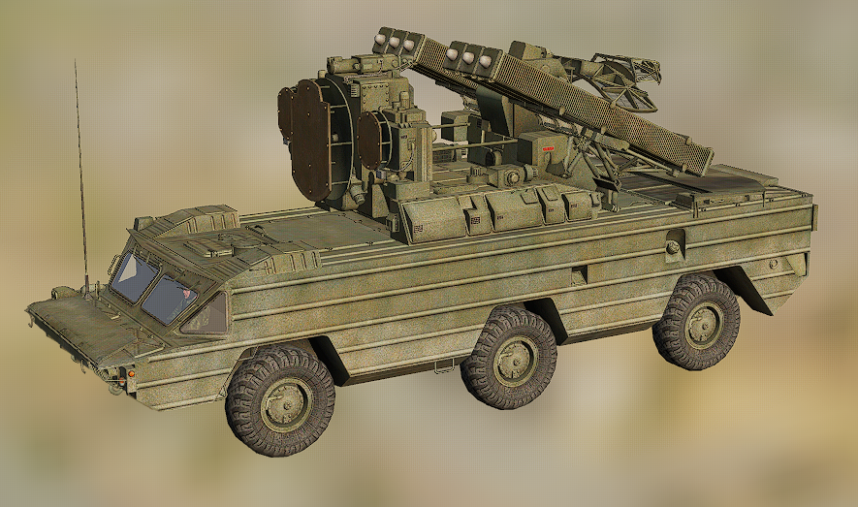
INTEL – GROUND THREAT SA-8

Slide 17
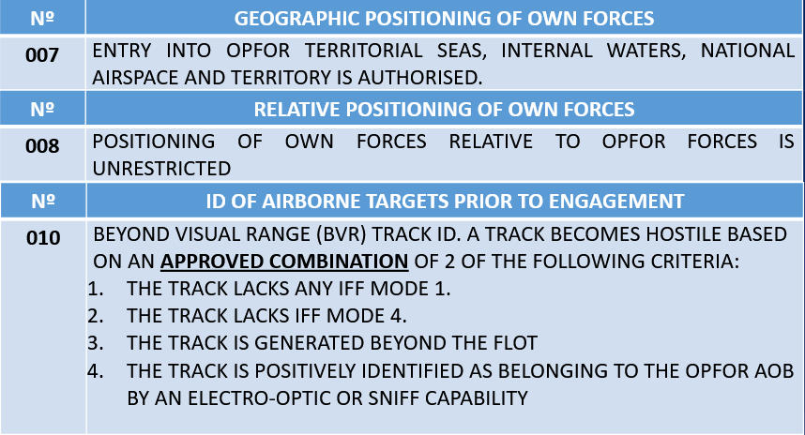
R.O.E A.A

Slide 18
R.O.E A.G

Slide 19
R.O.E ECM

Slide 20
R.O.E SEAD

Slide 21
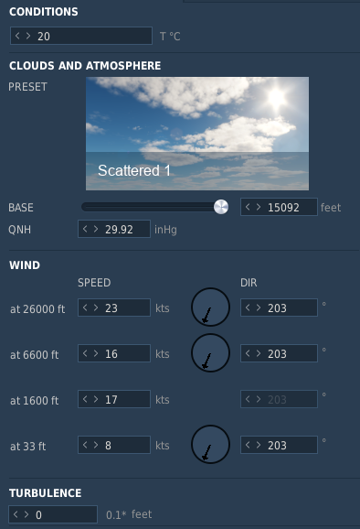
WEATHER UPDATE

Slide 22
DOMESTICS
MISSION MATERIALS
Commcard
Ground OPS: 251.0
Good engines: ALL
Check-in
Who: FL
Frequency: Intraflight
Time: COMMCARD
Taxi: COMMCARD.
Arming: AOR WEST
ROLEX
Authority / Freq / Codeword / ACK: MC/U8/COMMCARD/”LOBO, RGR, ROLEX X”
Departure
327.0
03R
VFR: NORTH FLEX, TLP NELLIS Local Procedures
Route: AS PLANNED.
Recovery
327.0
VFR ARCOE 21R

Slide 23
DEPARTURE FLOW
NELLIS AFB
HORNET 1 – T/O: 13:20
HORNET 2 – T/O: 13:22
VIPER 1 – T/O: 13:24
COBRA1 – T/O: 13:26

Slide 24
TANKER FLOW
TEXACO (1Y)-225.000MHz KC-135
FL150
VIPER1
ARCO (2Y)-226.000 MHz KC-135MPRS FL160
HORNET1
HORNET2
COBRA1

Slide 25
HOLDING
HORNET 1
HORNET 1 – FL280
HORNET 2 – FL260
VIPER 1 – FL180
COBRA1 – FL170
HORNET 2
VIPER 1
COBRA 1

Slide 26
PACKAGE FLOW
INGRESS
COBRA 1
VIPER 1
HORNET 2
HORNET 1
14:03
14:03
13:57
13:55

Slide 27
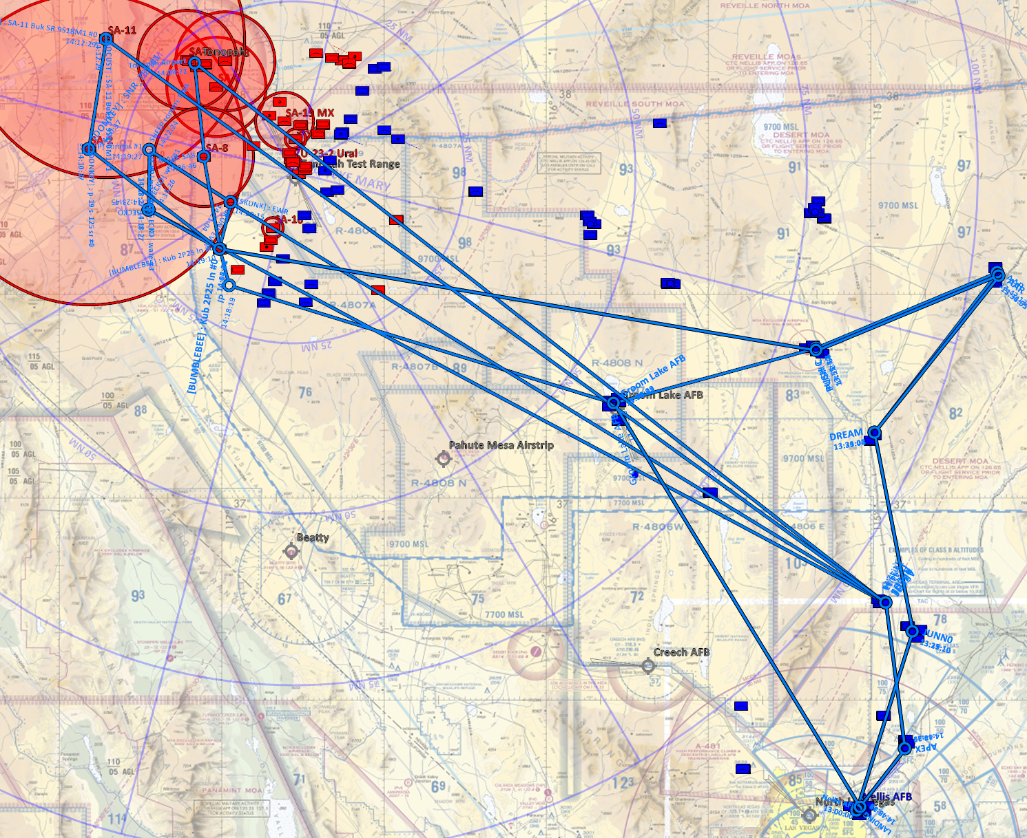
ROUTE

Slide 28
AI TARGET. TOT 14:15 – 14:20
TONOPAH AB
9 SU-30
16 MIG29S
TONOPAH TR
NO OPERATIONAL
SHEEP
GECKO
SKUNK

Slide 29
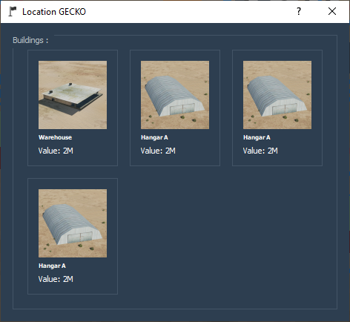
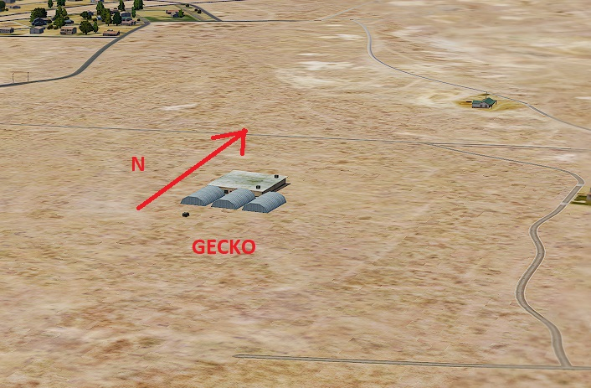
AI TARGET. TOT 14:15 – 14:20
GECKO COMPLEX

Slide 30
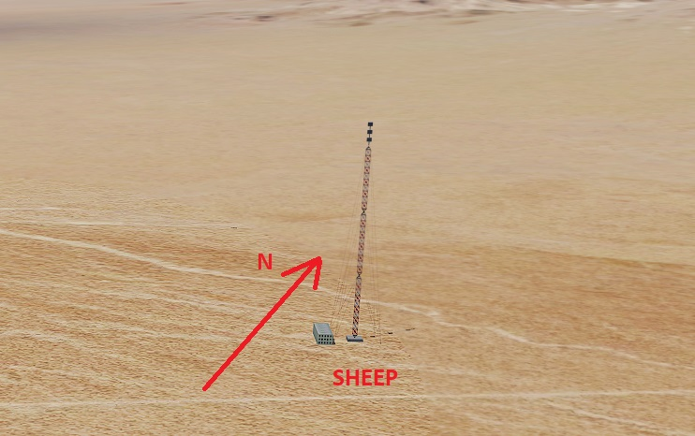
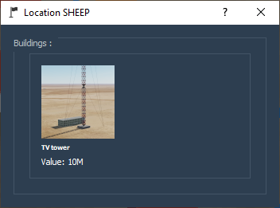
AI TARGET. TOT 14:15 – 14:20
SHEEP COMM TWR

Slide 31
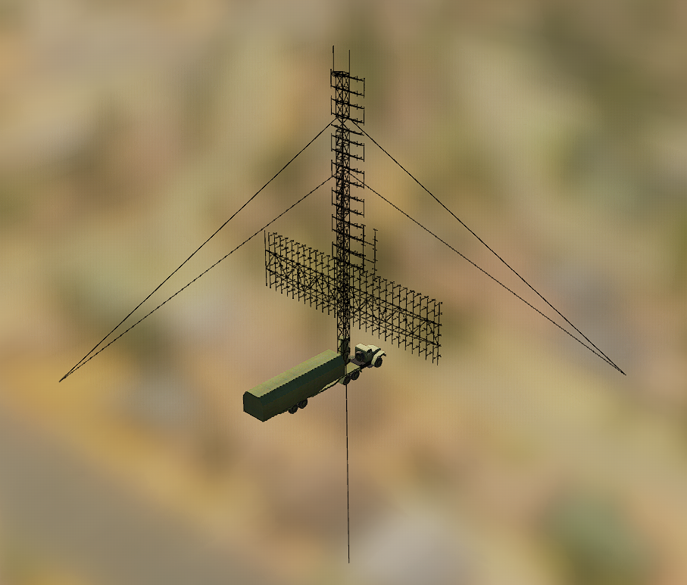
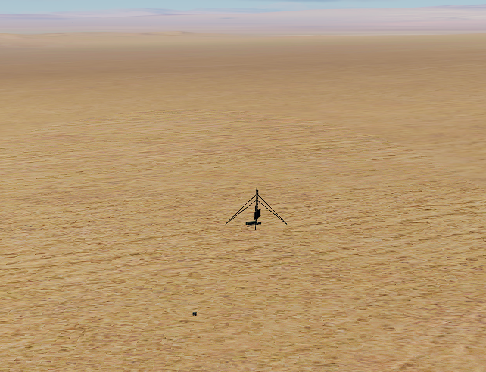
AI TARGET. TOT 14:15 – 14:20
SKUNK EWR 55CG6
N

Slide 32
SEAD – SBAD TREAT
TONOPAH AB
9 SU-30
16 MIG29S
SA-11
LOCUST
SA-8
TONOPAH TR
NO OPERATIONAL
SA-2
DONKEY
SA-8
MARE

Slide 33
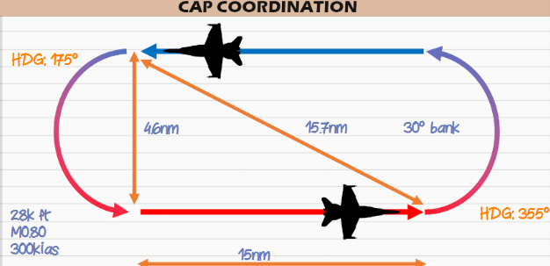
SWEEP
TONOPAH AB
9 SU-30
16 MIG29S
TONOPAH AB
9 SU-30
16 MIG29S
TONOPAH TR
NO OPERATIONAL
CAP BRAVO
CAP ALPHA

Slide 34
GAMEPLAN

Slide 35
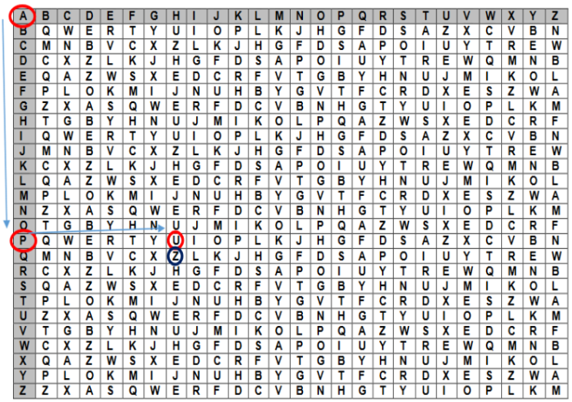
AUTHENTICATION
RAMROD: MURCIELAGO
AMSL1800

Slide 36
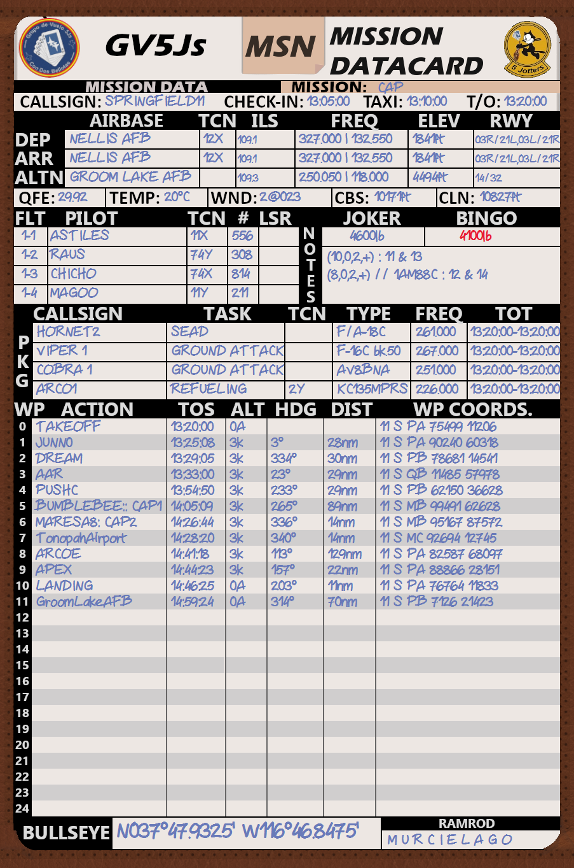
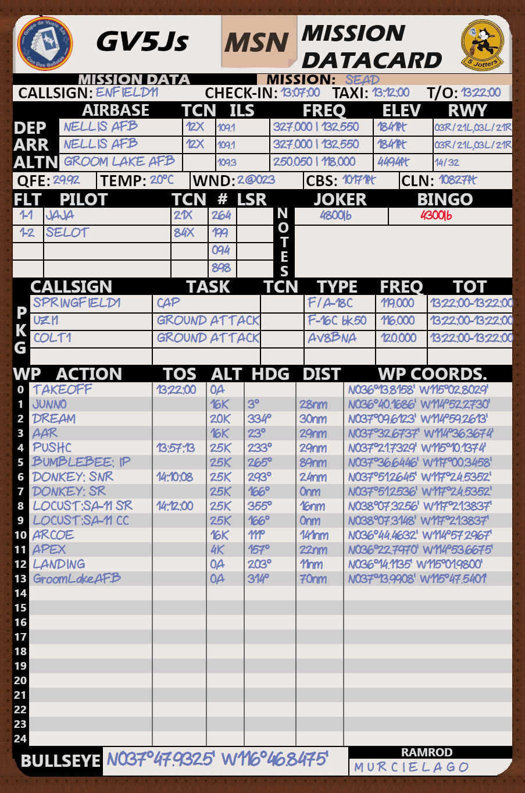
KNEEBOARD INFO

Slide 37
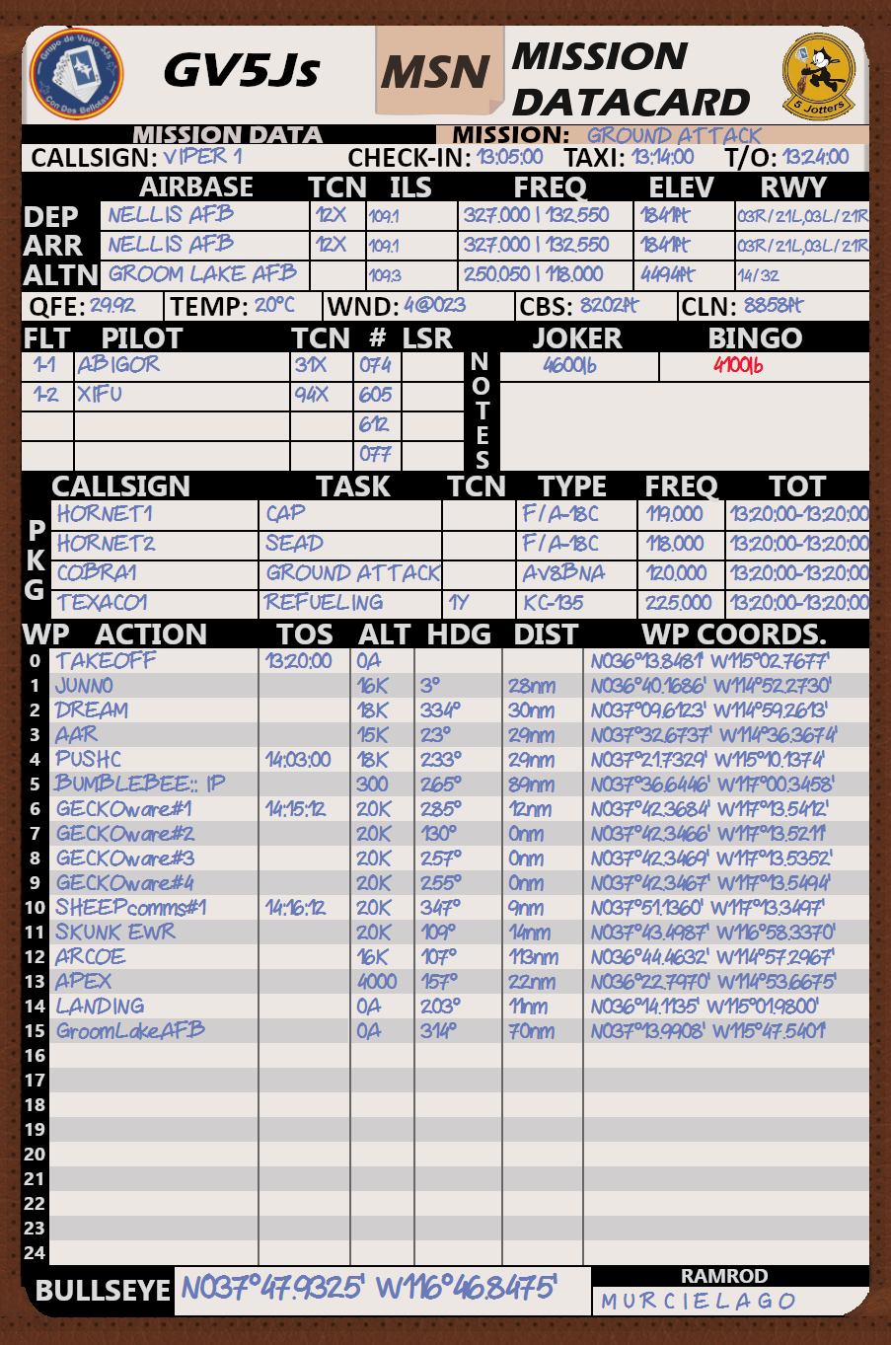
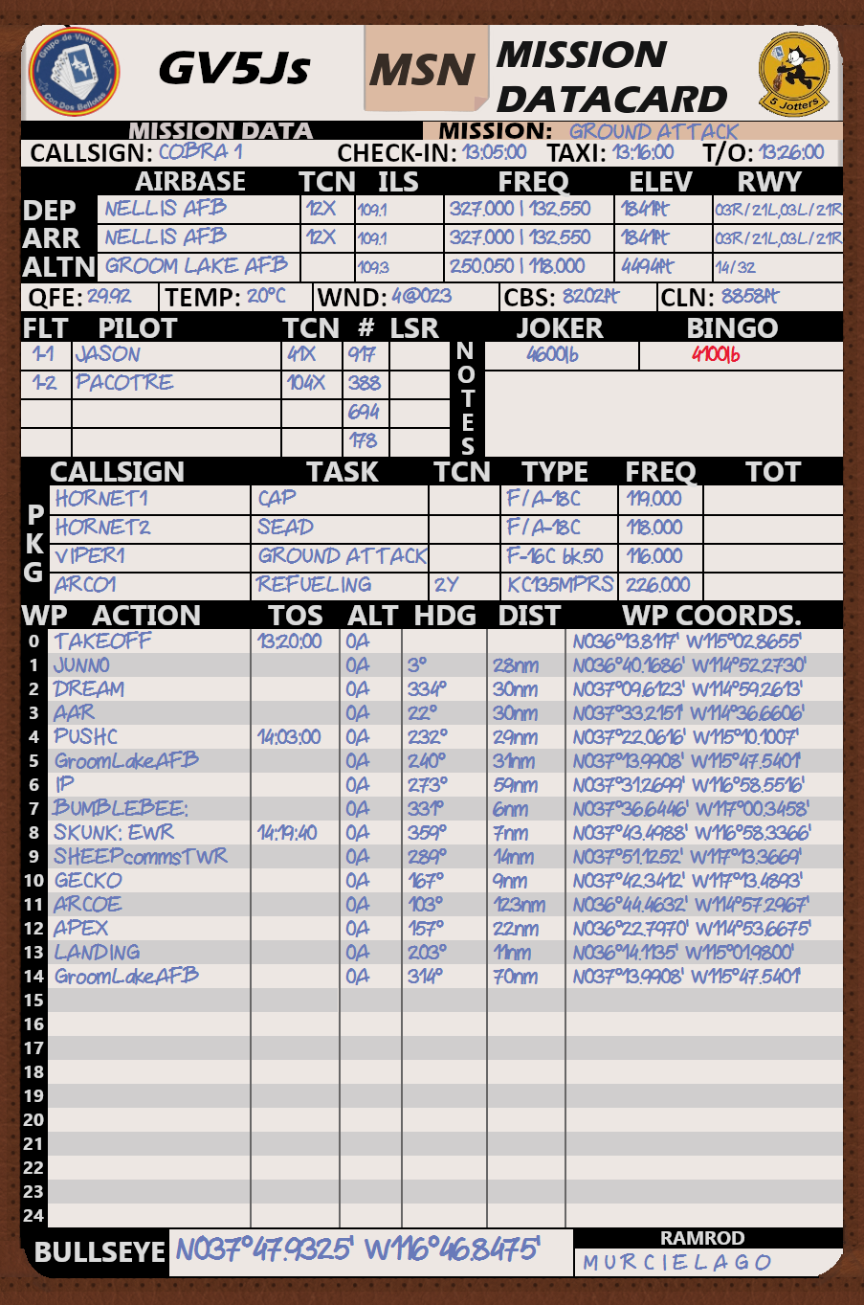
KNEEBOARD INFO

Slide 38
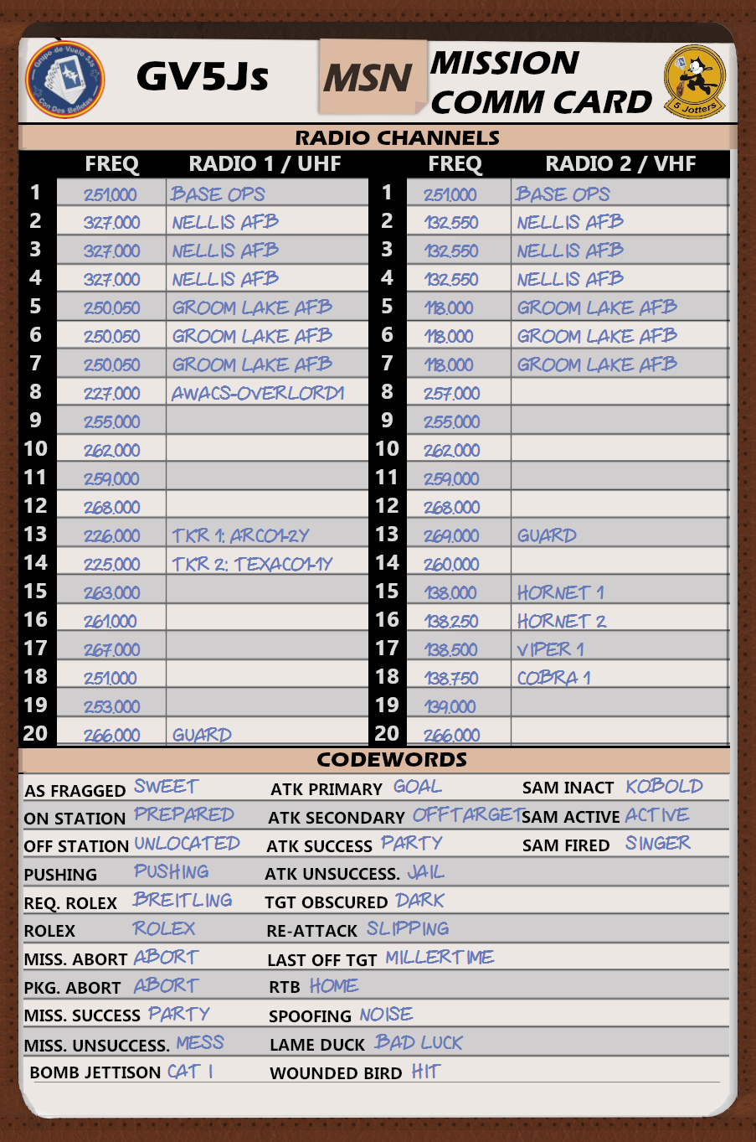
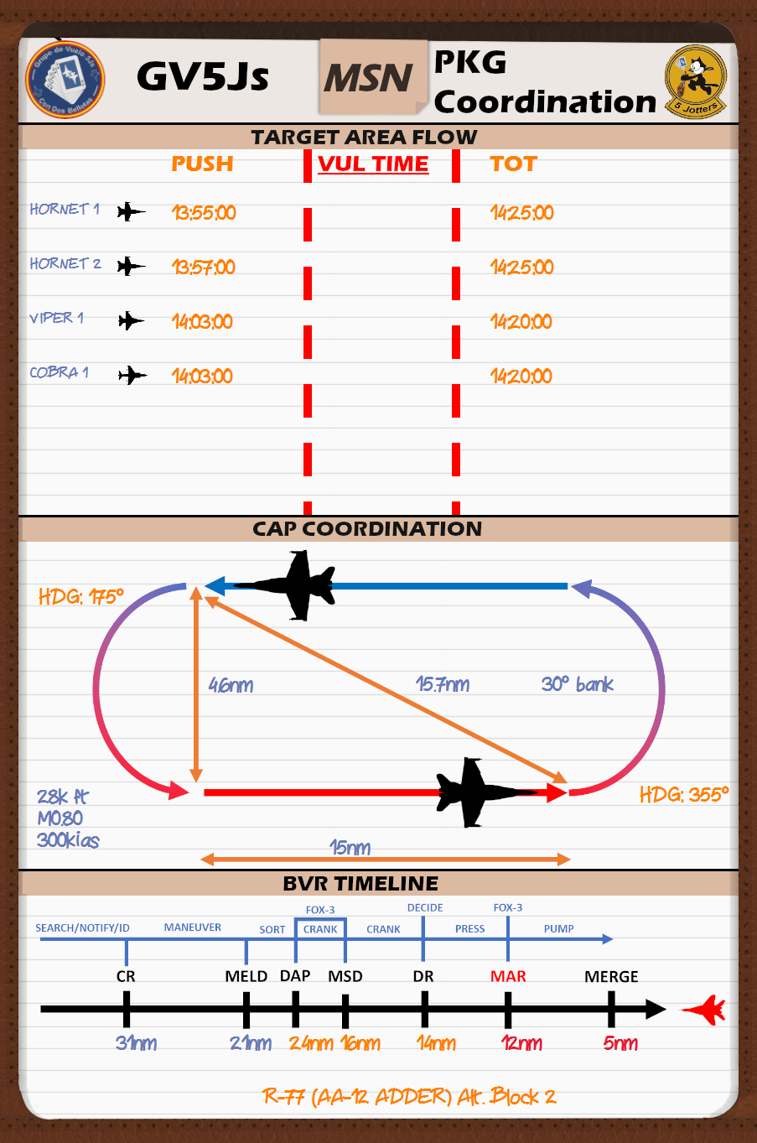
KNEEBOARD INFO

Slide 39
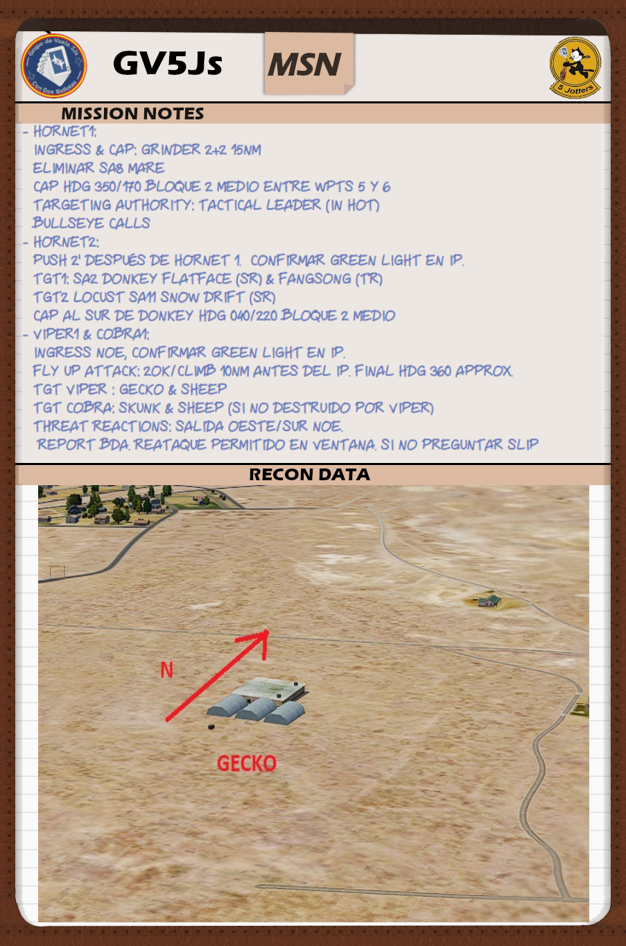
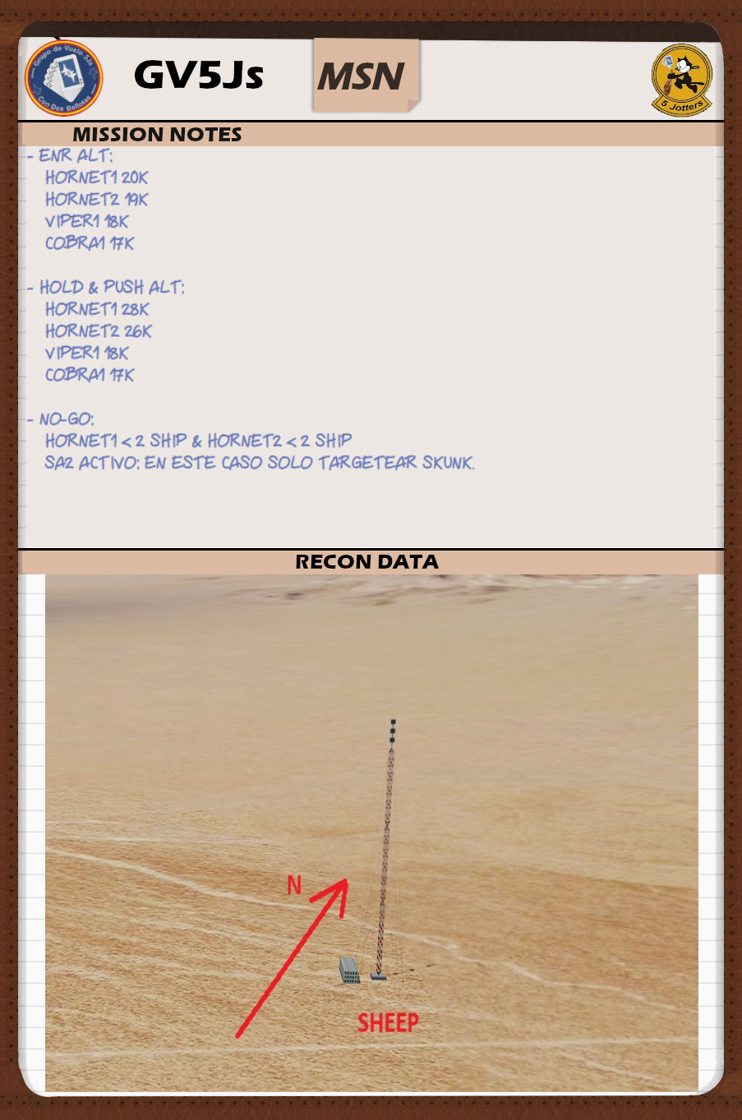
KNEEBOARD INFO

Slide 40
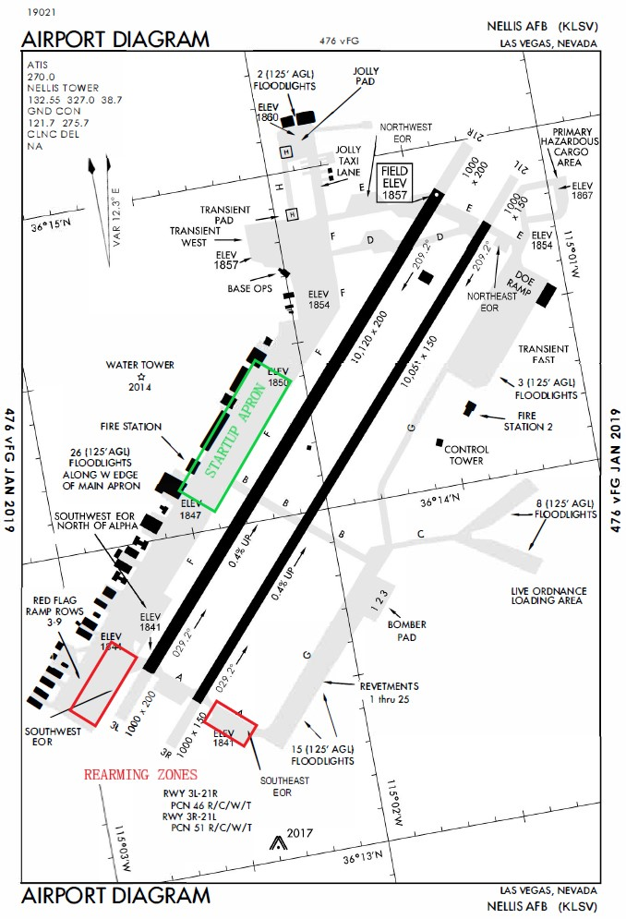
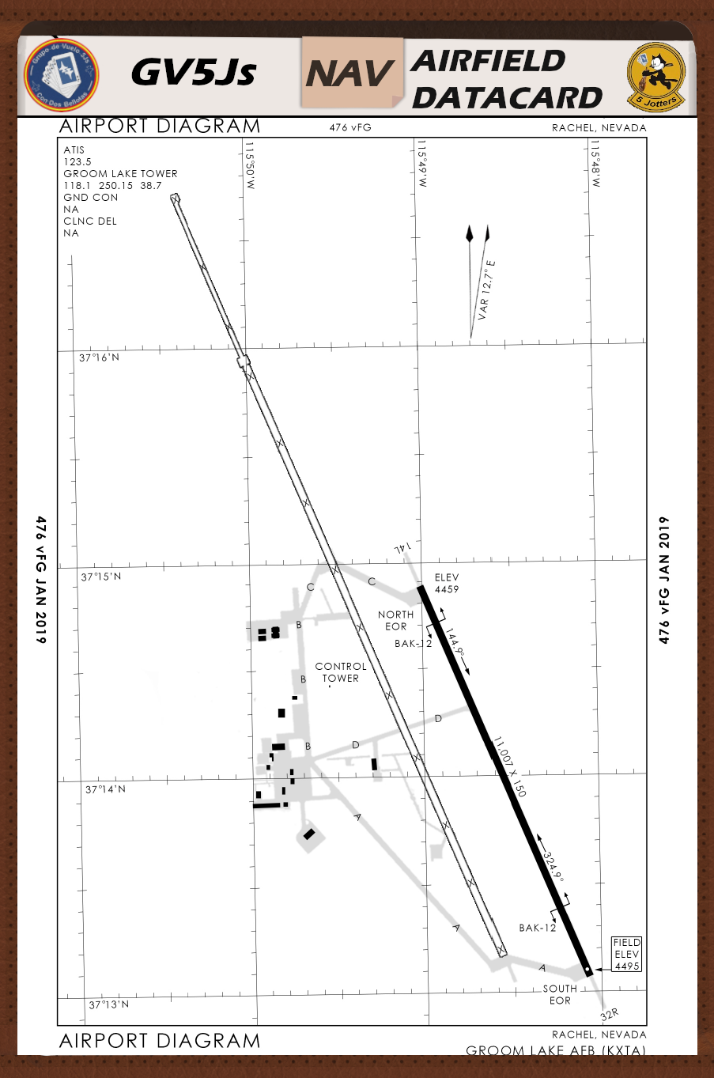
KNEEBOARD INFO

Slide 41
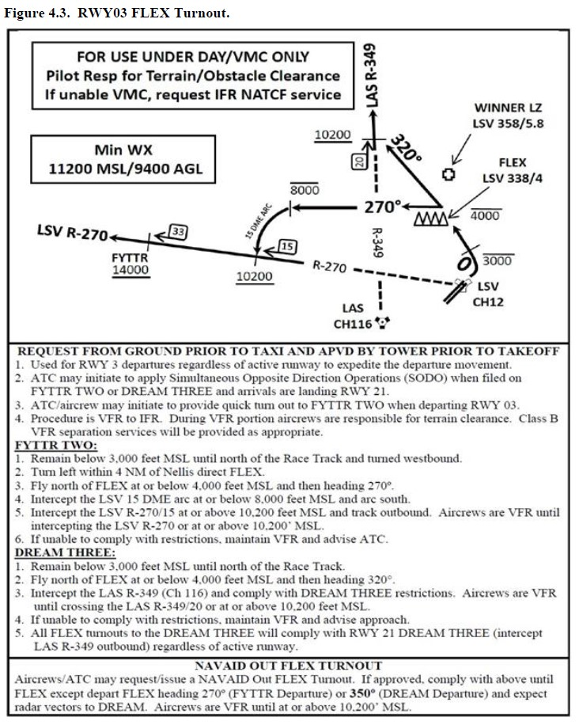
KNEEBOARD IINFO

Slide 42
Q?

Slide 43
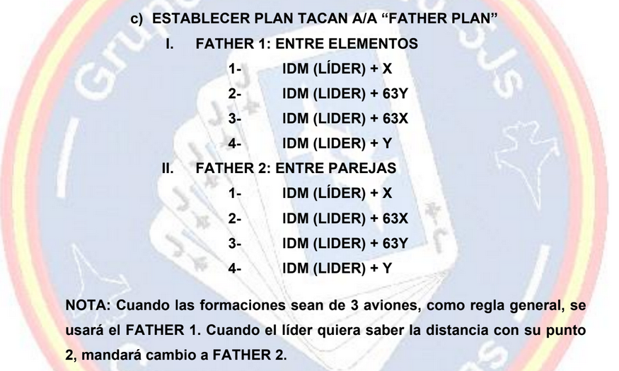
SOP OF THE DAY

